Slide 1

STATUS REPORT
Team Name: Sharktooth Software
Team Members: Alexandru Cioanca, Andrew Dutton, Dustin Phan​, Gabriel Molina​, Roberto Carvalho Brigagao, Thuan Nguyen
Date: 3/14/2024

Slide 2
Metrics* Table *A software metric is a measure of software characteristics that are quantifiable or countable. Software metrics are important for many reasons, including measuring software performance, planning work items, measuring productivity, and many other uses. NOTE: Study each Metric’s definition and determine whether is is applicable to your project
 | Week 1 | Week 2 | Week 3 | Week 4 | Week 5 | Week 6 | Week 7 | Week 8 | Week N
CPI | 1 | 1 | 1 | 1 | 1
RCM (Business Application) | 10% | 10% | 10% | 10% | 10%
Error Density | N/A | N/A | N/A | N/A | N/A
MTTF | N/A | N/A | N/A | N/A | N/A
MTTR | N/A | N/A | N/A | N/A | N/A
AVAIL. | N/A | N/A | N/A | N/A | N/A
SMI | 0% | 0% | 5% | 5% | 5%

Slide 3
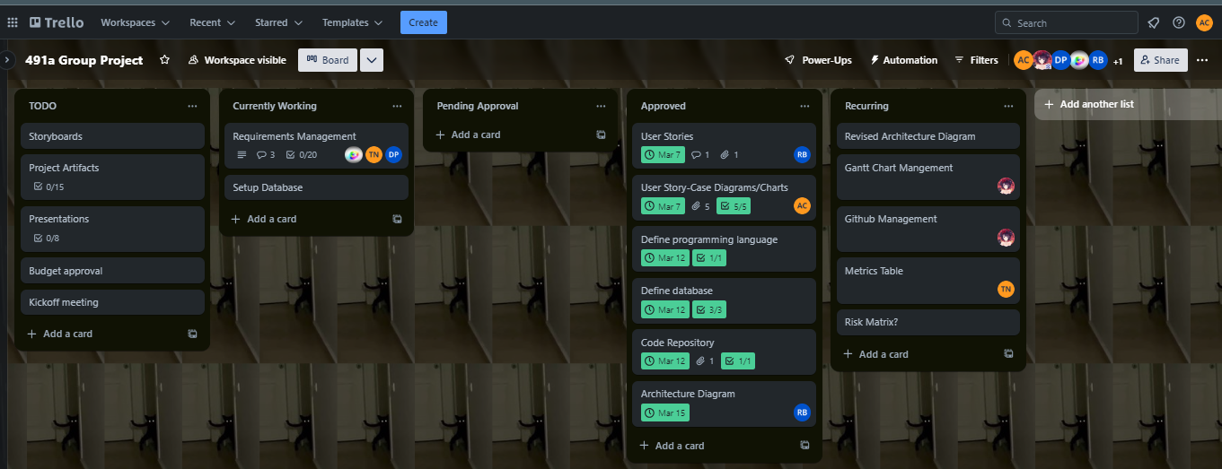
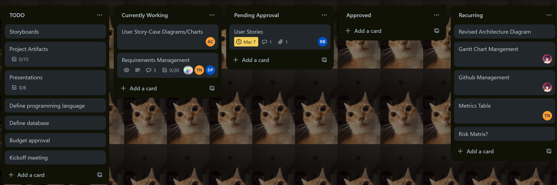
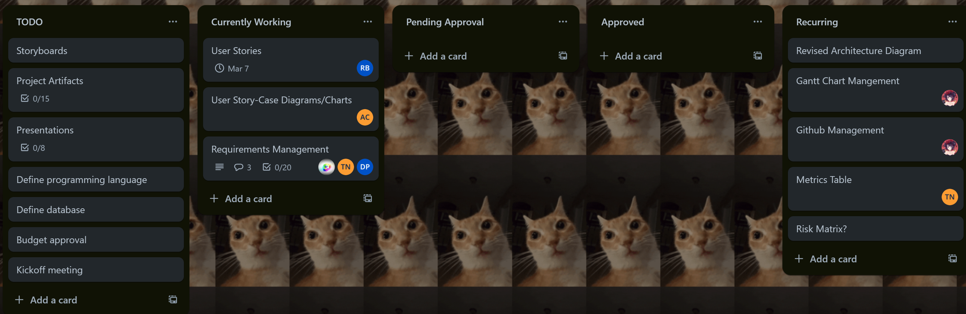
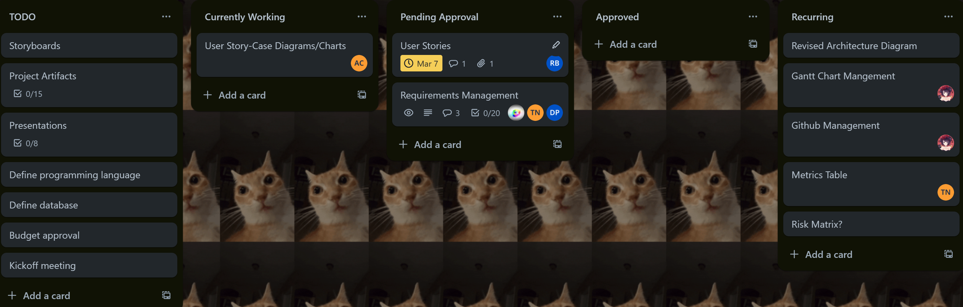
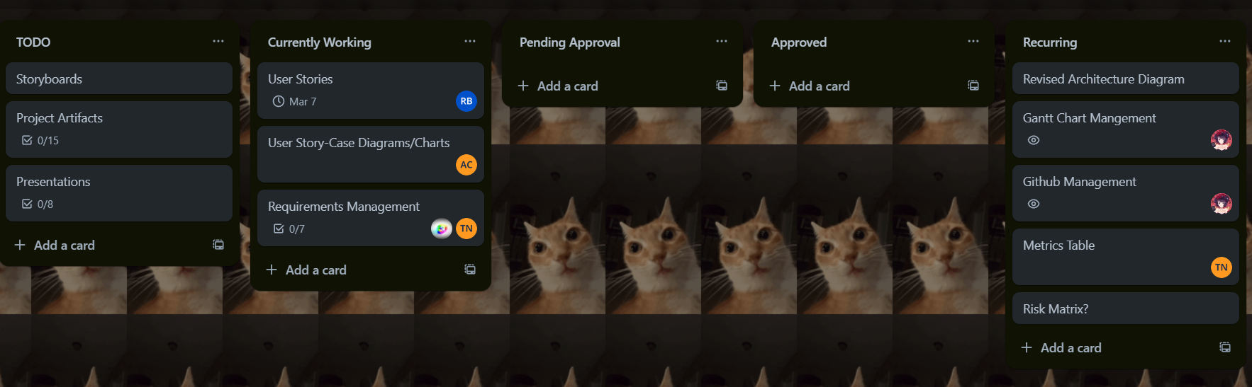
Integrated Schedule (1 or 2 Slides)

Slide 4
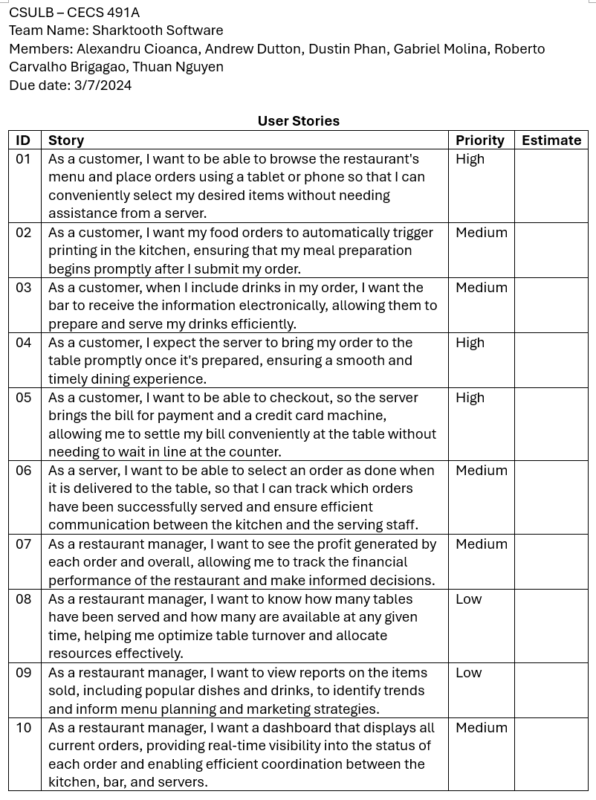
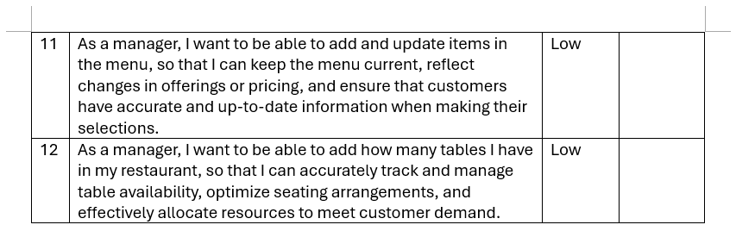
User Stories

Slide 5
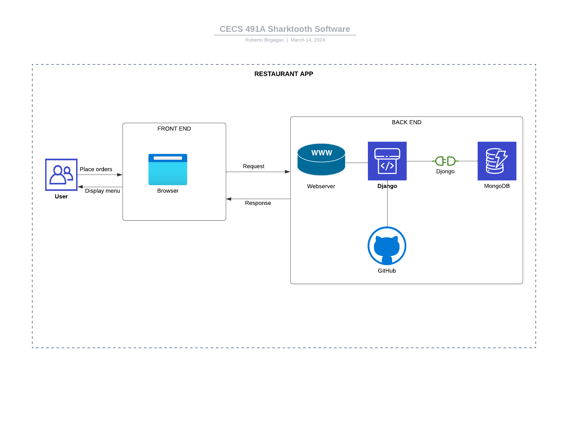
Architecture Diagram

Slide 6
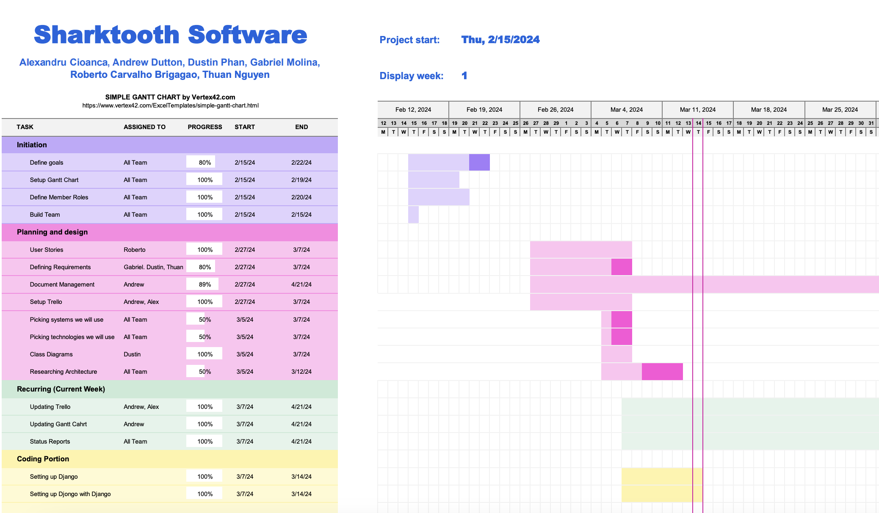
Gantt Chart 3/14/2024

Slide 7
What Everyone is Working on - week 3/14/2024
Alexandru Cioanca
Updating Trello
Defining database information
Status Report Update
Andrew Dutton
Working on updating Gantt Chart, CPI, RCM, SCM
Database Backend w/MongoDB
Dustin Phan​
Catching Up
Gabriel Molina​
Database Backend w/ MongoDB
Roberto Carvalho Brigagao
Design Architecture Diagram
Thuan Nguyen
Catching Up w/ MongoDB Database

